Slide 1

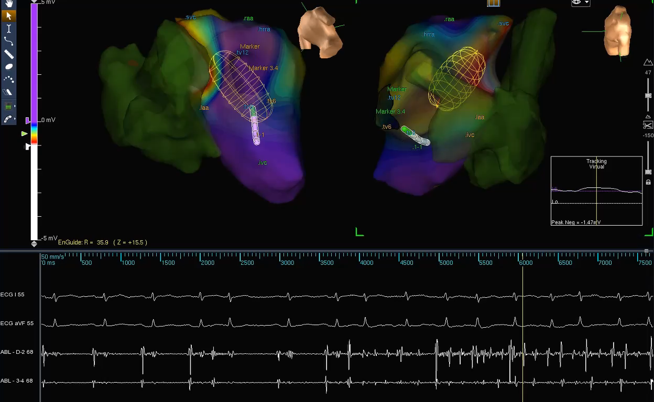
AF-HFpEF: FUTURE CHALLENGES They are numerous!! Bi-atrial Drivers and Substrate
Saksena S, Skadsberg N et al: Biatrial and 3-Dimensional Mapping of spontaneous atrial arrhythmias in patients with refractory atrial fibrillation. Journal of Cardiovasc. Electrophysiol. May 2005; 16(5):494-504

Slide 2

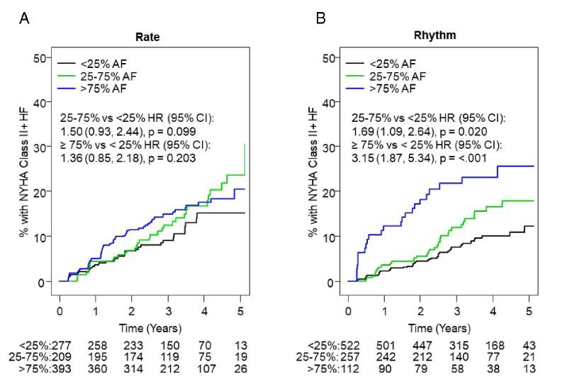
EMERGENCE OF HF IN AN AF ONLY POPULATION IMPACT OF DEGREE OF RHYTHM CONTROL IN AF
IS THERE A ROLE FOR AF BURDEN?
Slee A, Saksena S: Am Heart J. 2020 Feb;220:1-11.

Slide 3

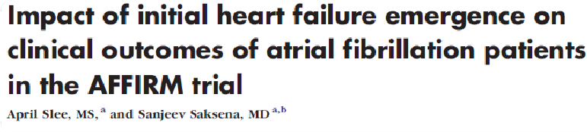
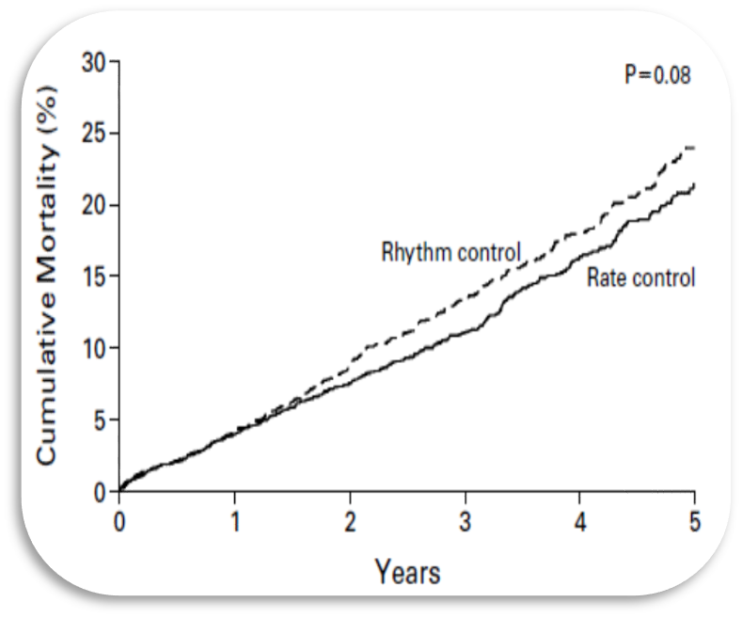

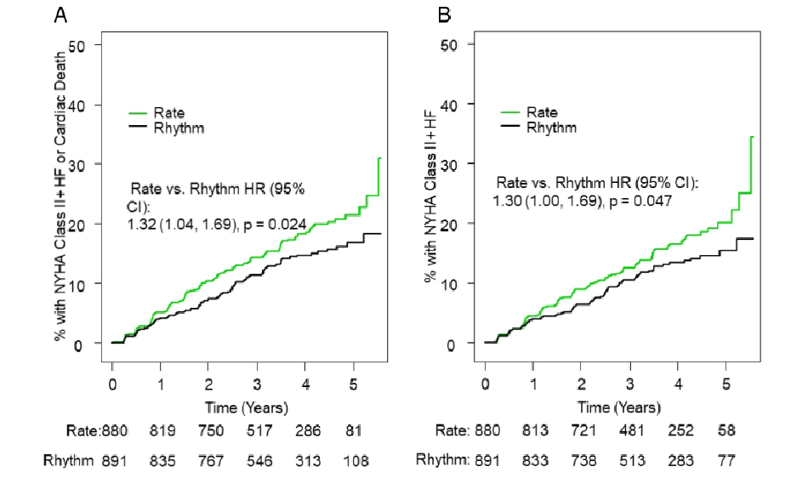
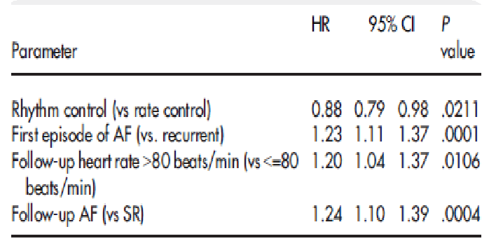

AFFIRM TRIAL
Post-Hoc Analysis for HF Emergence
Primary endpoint – All cause Mortality N Engl. J. Med 2002:347:1925-33
Primary endpoint – HF Emergence and CV Death
Slee A, Saksena S: Am Heart J. 2020 Feb;220:1-11.

Slide 4
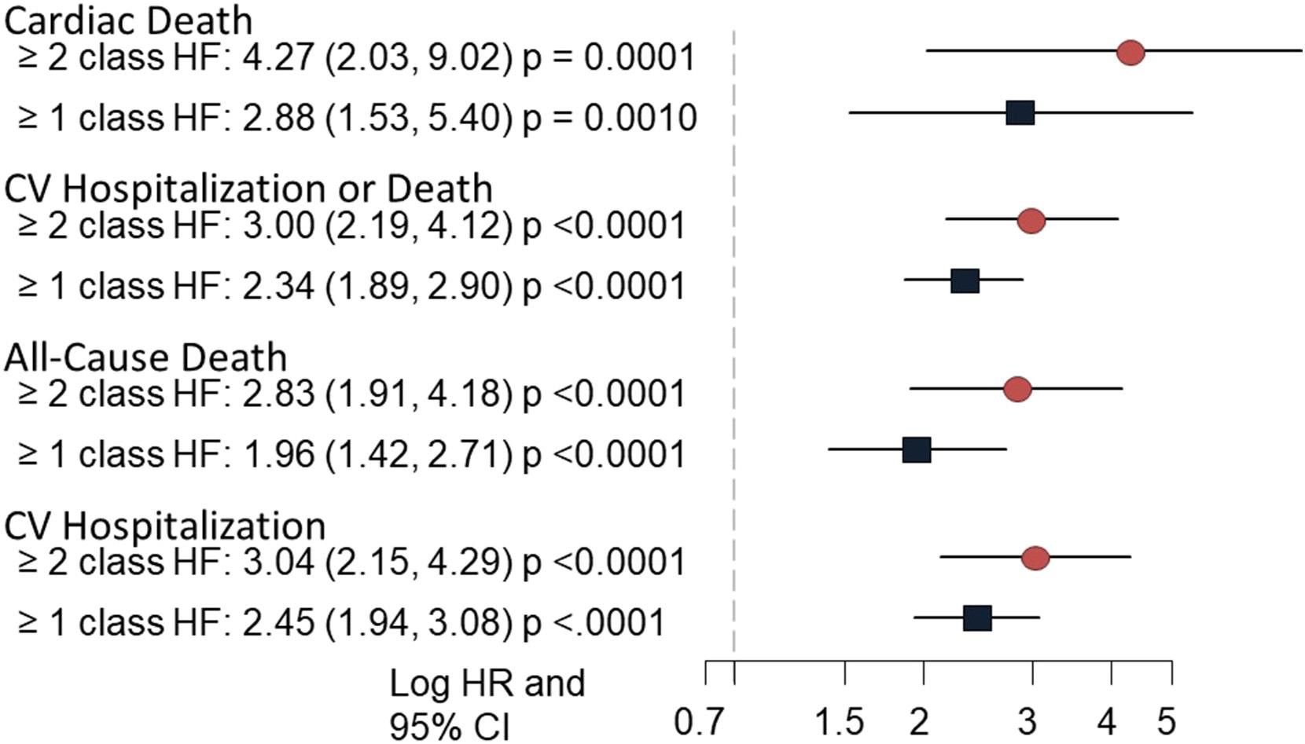
AF LEADING TO HF (pEF) EMERGENCE IMPACTS MAJOR CV OUTCOMES AND SURVIVAL:
AFFIRM TRIAL
New onset HF emergence predicts morbidity and mortality in AF
HF emergence in AF is promoted by uncontrolled VR, persistent AF and recurrent AF and delayed by effective rhythm control
Slee A, Saksena S: Impact of initial heart failure emergence on clinical outcomes of atrial fibrillation patients in the AFFIRM trial; , Am. Heart J. 2020;220:1-11.

Slide 5
AF & HFpEF: TOPCAT TRIAL
Cause specific CV mortality: PSM cohorts
Heart failure and sudden death
contributions
Impact of Any AF and AF on ECG is seen on pump failure death alone
Saksena et al: Atrial Fibrillation (AF) can adversely impact Heart Failure with Preserved Ejection Fraction (HFpEF) by its association with Heart Failure (HF) Progression and Mortality. Europace EP (2023) 25 1–14

Slide 6
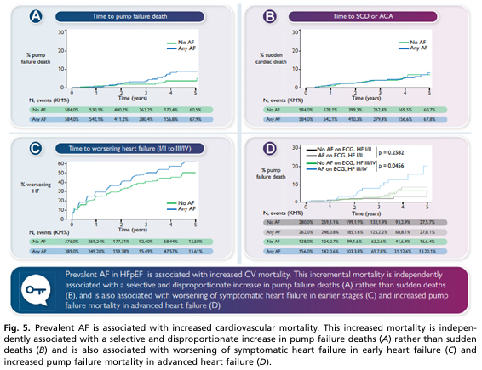
AF & HFpEF: TOPCAT TRIAL
AF & HF progression and HF death
Saksena et al: Europace (2023) 25 1–14

Slide 7
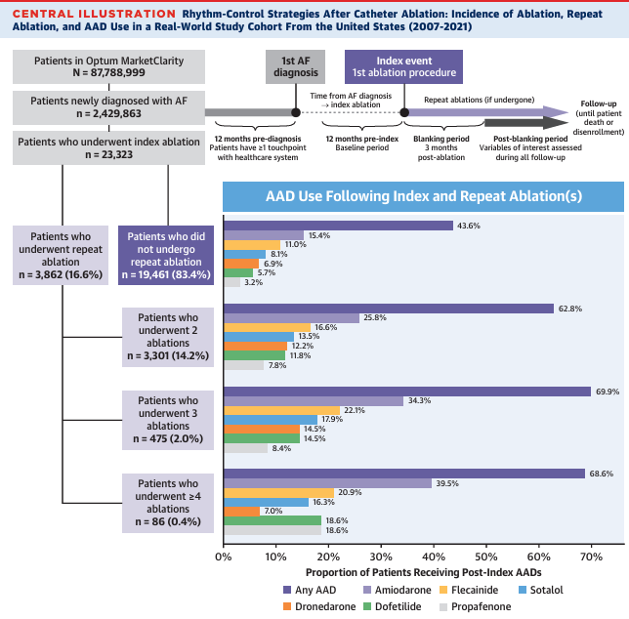
AF-HFpEF: FUTURE CHALLENGES
.
.
The need for “Hybrid” Therapy : ARCC-AF trial
Saksena S, et al: Arrhythmia Recurrence and Rhythm Control Strategies After Catheter Ablation of Newly Diagnosed Atrial Fibrillation (ARRC-AF ) study. J. Am. Coll. Cardiol.EP 2025:11:763-775

Slide 8
ARCC-AF trial
We practice “Hybrid” Therapy much more often than monotherapy
Saksena S, et al: Arrhythmia Recurrence and Rhythm Control Strategies After Catheter Ablation of Newly Diagnosed Atrial Fibrillation (ARRC-AF ) study. J. Am. Coll. Cardiol.EP 2025:11:763-775

Slide 9
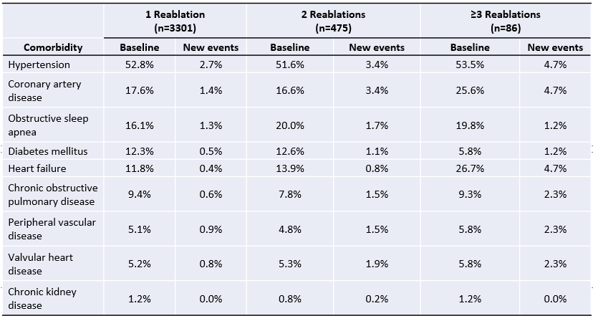
ARCC-AF trial
The Continuing Emergence of Comorbidities requires “Hybrid” Rx beyond Arrhythmia Rx
TOTAL BURDEN 8.6% 15.5% 23.4%
Saksena S, et al: Arrhythmia Recurrence and Rhythm Control Strategies After Catheter Ablation of Newly
Diagnosed Atrial Fibrillation (ARRC-AF ) study. J. Am. Coll. Cardiol.EP 2025:11:763-775

Slide 10
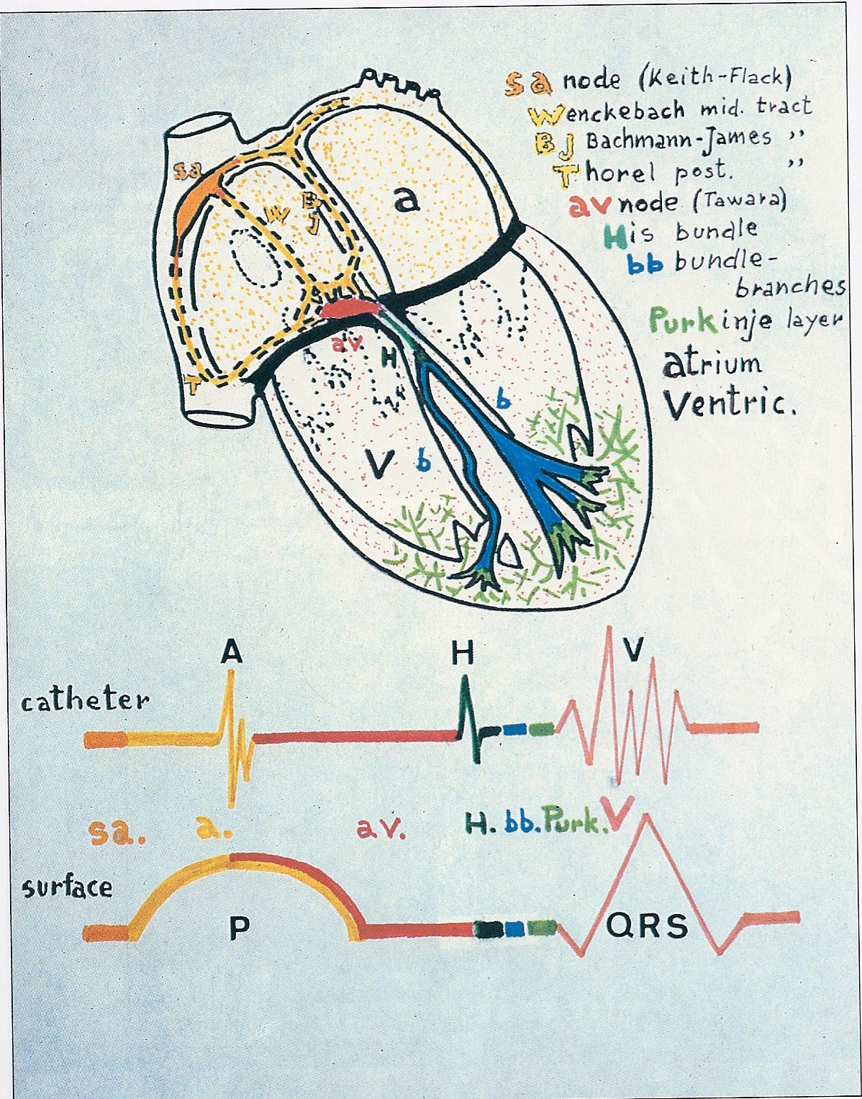
ATRIAL ANATOMY AND PHYSIOLOGY IMPACT
Alternative Site Atrial Pacing: EP Effects on RA & LA
Rossi and Maturri, 1990

Slide 11
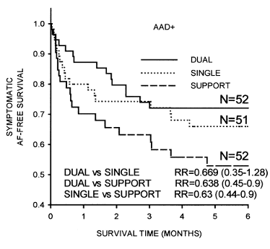
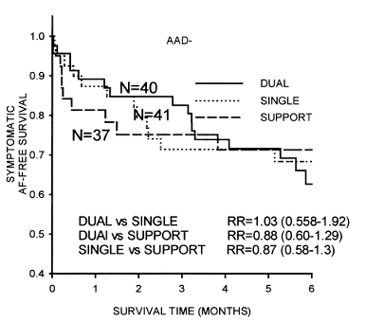
DAPPAF Trial : The Need for “Hybrid” Therapy
Clinical Needs versus Available Technology
 | Paired Wilcoxon sign test
Dual vs Single, n=19 | p=0.064
Dual vs Support, n=23 | p=0.011
Single vs Support, n=25 | p=0.108
 | Paired Wilcoxon sign test
Dual vs Single, n=16 | p=1.0
Dual vs Support, n=15 | p=1.0
Single vs Support, n=12 | p=1.0
RR = 0.669
RR = 0.638
Dual-site RA pacing showed incremental benefits with respect to AF prevention derived almost exclusively in the large (82%) subgroup receiving antiarrhythmic drug therapy.
N=40
N=52
N=41
N=51
N=37
N=52
In patients on class 1 or 3 antiarrhythmic drugs with a baseline symptomatic AF event rate <1 per week (78 patients, 66% of the study population), there was a significantly longer AF-free survival with dual-site RA pacing as compared with high RA pacing (Cox proportional hazards survival ratio 0.46, paired Wilcoxon p=0.006)

Slide 12

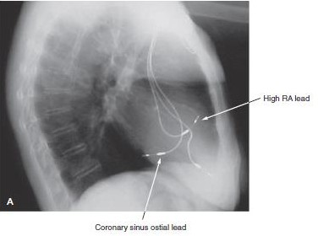


AF-HFpEF:IMPROVE LA HEMODYNAMICS AIM: TO ACHIEVE REVERSE LA/LV REMODELING
DAPPAF Trial
Atrial Resynchronization for Rhythm Control in AF: Dual Atrial Pacing(DAP) : Technique and Hemodynamic Impact
Saksena et al: J. Am Coll Cardiol 1996;28:687-694
DAP + AAD establishes:
Rhythm control in >80% of subjects long term ( >3 years)
AV synchrony
Sinus rhythm
Dual site Atrial Pacing
-Enhanced MV flow improves LV filling beyond restoring AV synchrony
Madan N, Saksena S:Long-term rhythm control of drug- refractory atrial fibrillation with "hybrid. Am J Cardiol. 2004 Mar 1;93(5):569-75
46

Slide 13

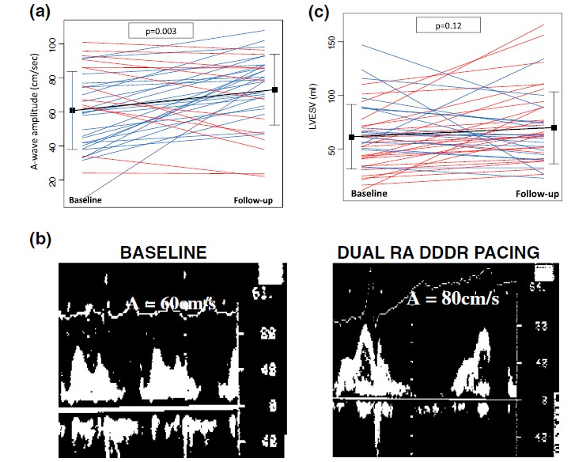
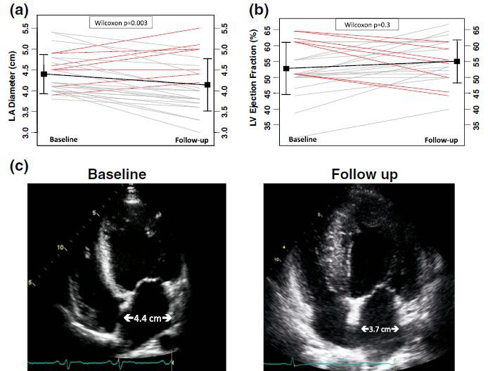
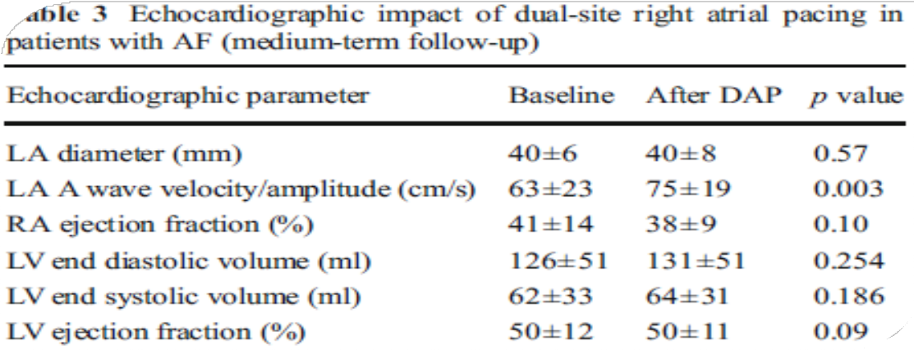
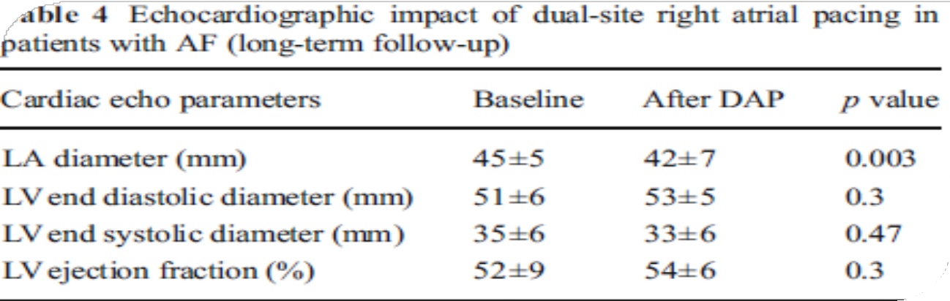
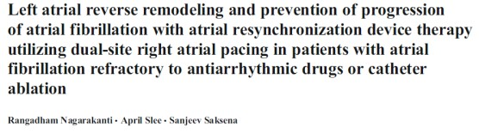
DUAL RA PACING + RHYTHM CONTROL IN AF
STAGED REVERSE REMODELING- 6 & 36 MOS
NO SUCH REVERSE REMODELING HAS BEEN DEMONSTRATED
FOR ANY SINGLE SITE PACING MODE IN AF

Slide 14
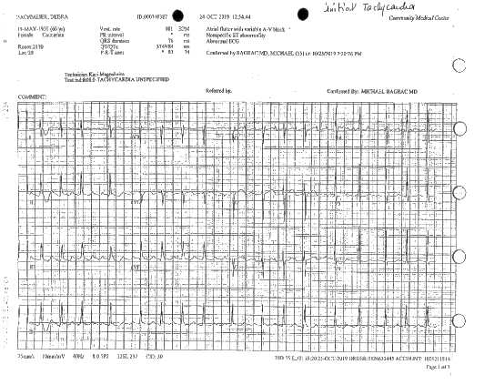
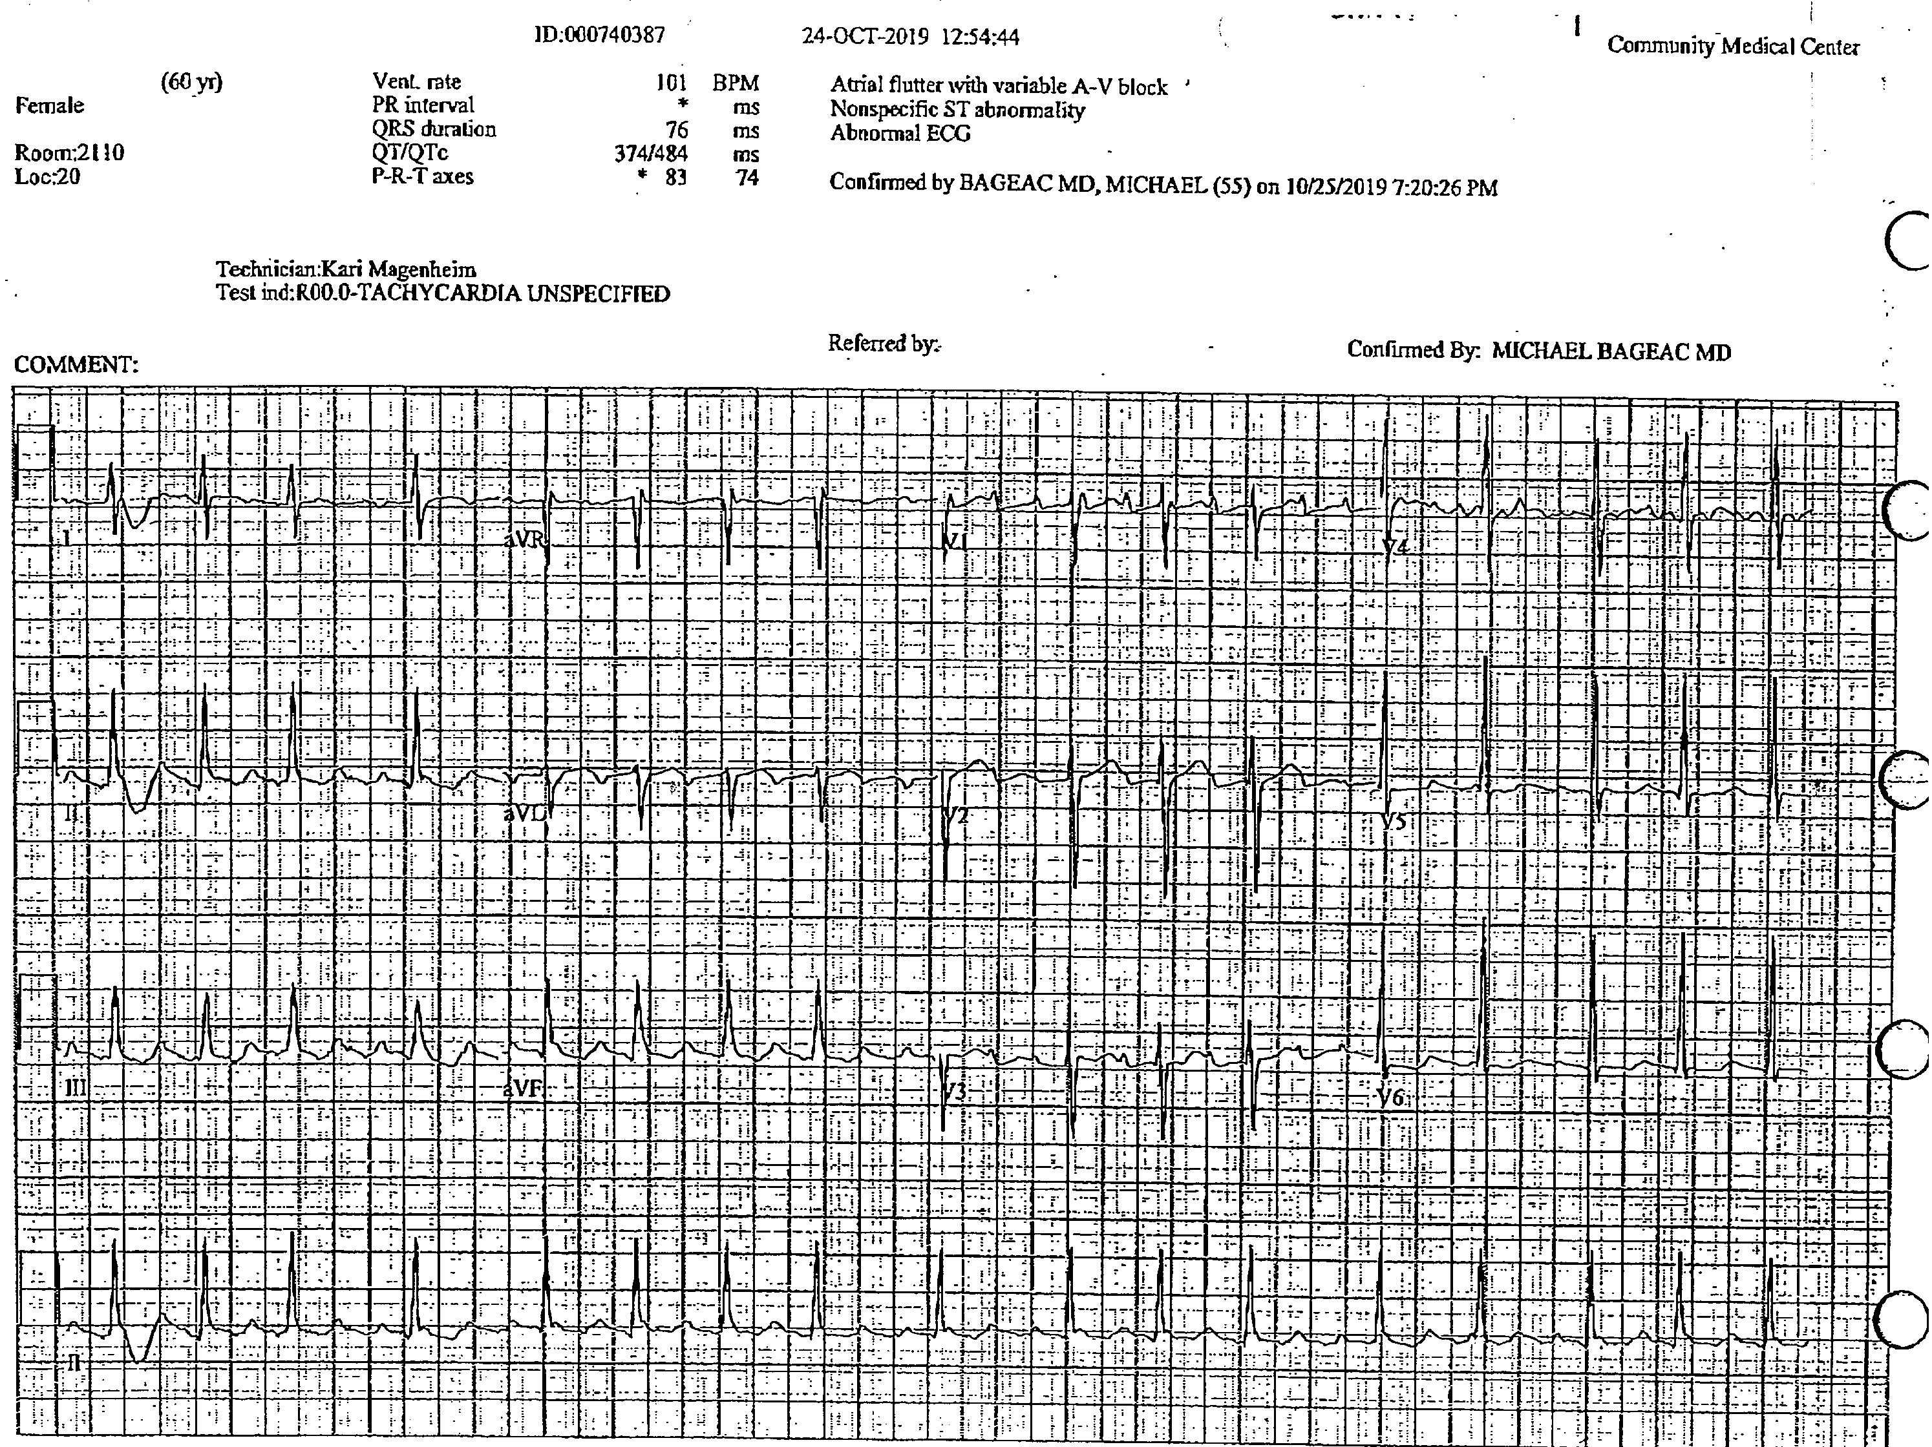
ATRIAL RESYNCHRONIZATION after AF ablation
11/2020 : 61 yr old woman with palpitations and exertional dyspnea on minimal exertion;Adult CHD, corrected coarctation of aorta and ASD at age 1
2016 –PAF started on apixaban and PVI done in Tenneseee; 2018 – AF recurred;started rate control; HFpEF emerged
5/2020 & 6/2020- Left AT ablation, A Flutter =CTI and empiric IVC-SVC; Simus exit block on amiodarone; NYHA 3 HpEF with AF with pulm. edema
10/20 – Reablation of Left AT, gap closures in CTI, intercaval line
11/20 –Atrial flutter and left sided AT
2019
2020

Slide 15
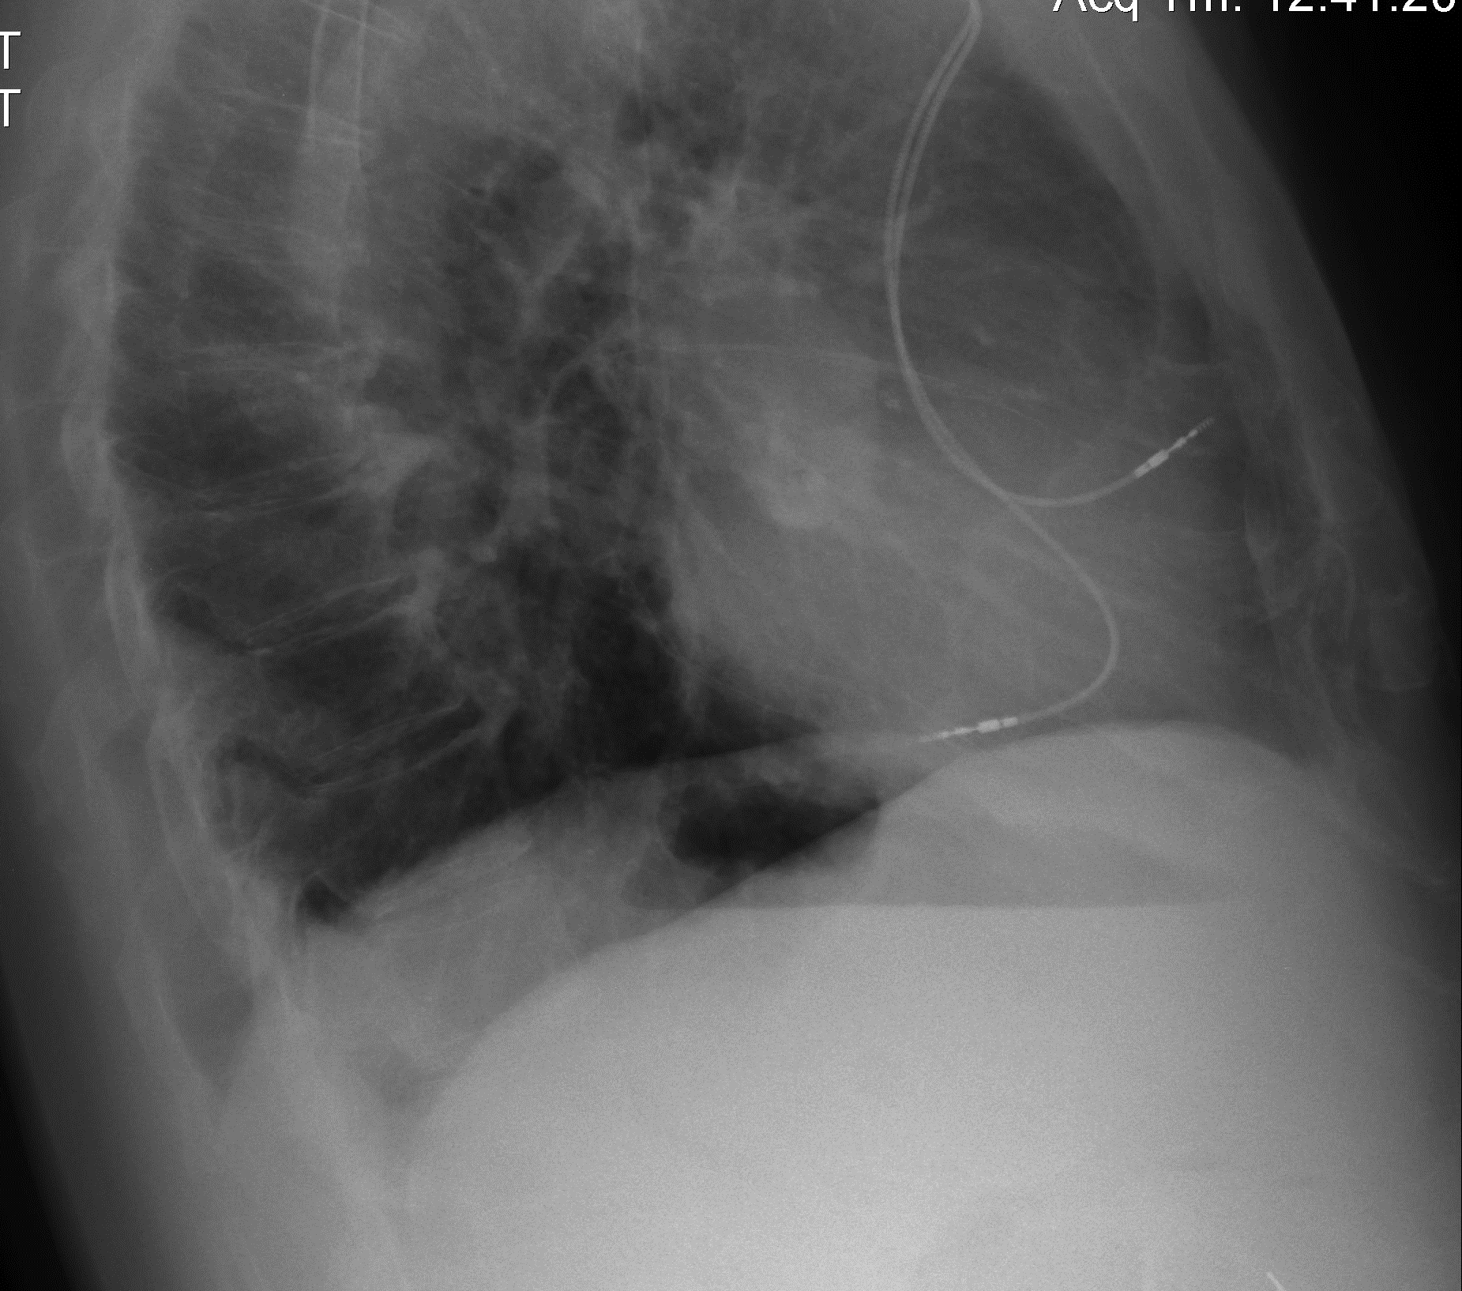
Hybrid Therapy
Atrial Resynchronization after AF ablation X4
11/20: SN exit block with amiodarone
12/20 - EPS- Intact AV conduction; Dual site RA pacemaker inserted with two leads ( RA & Csos); amiodarone & warfarin; 1 week f/up – 94% AP, no AF, no HF
1/21 – Amiodarone stopped; Dronedarone started
AAIR system

Slide 16
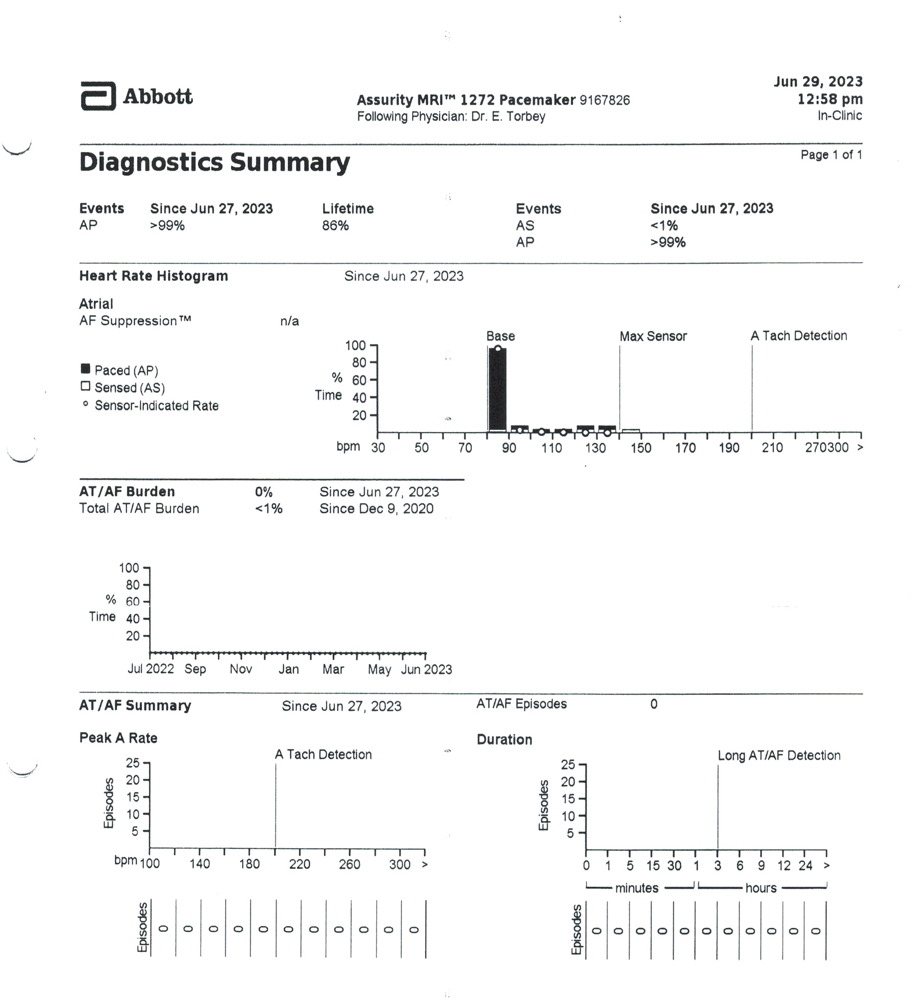
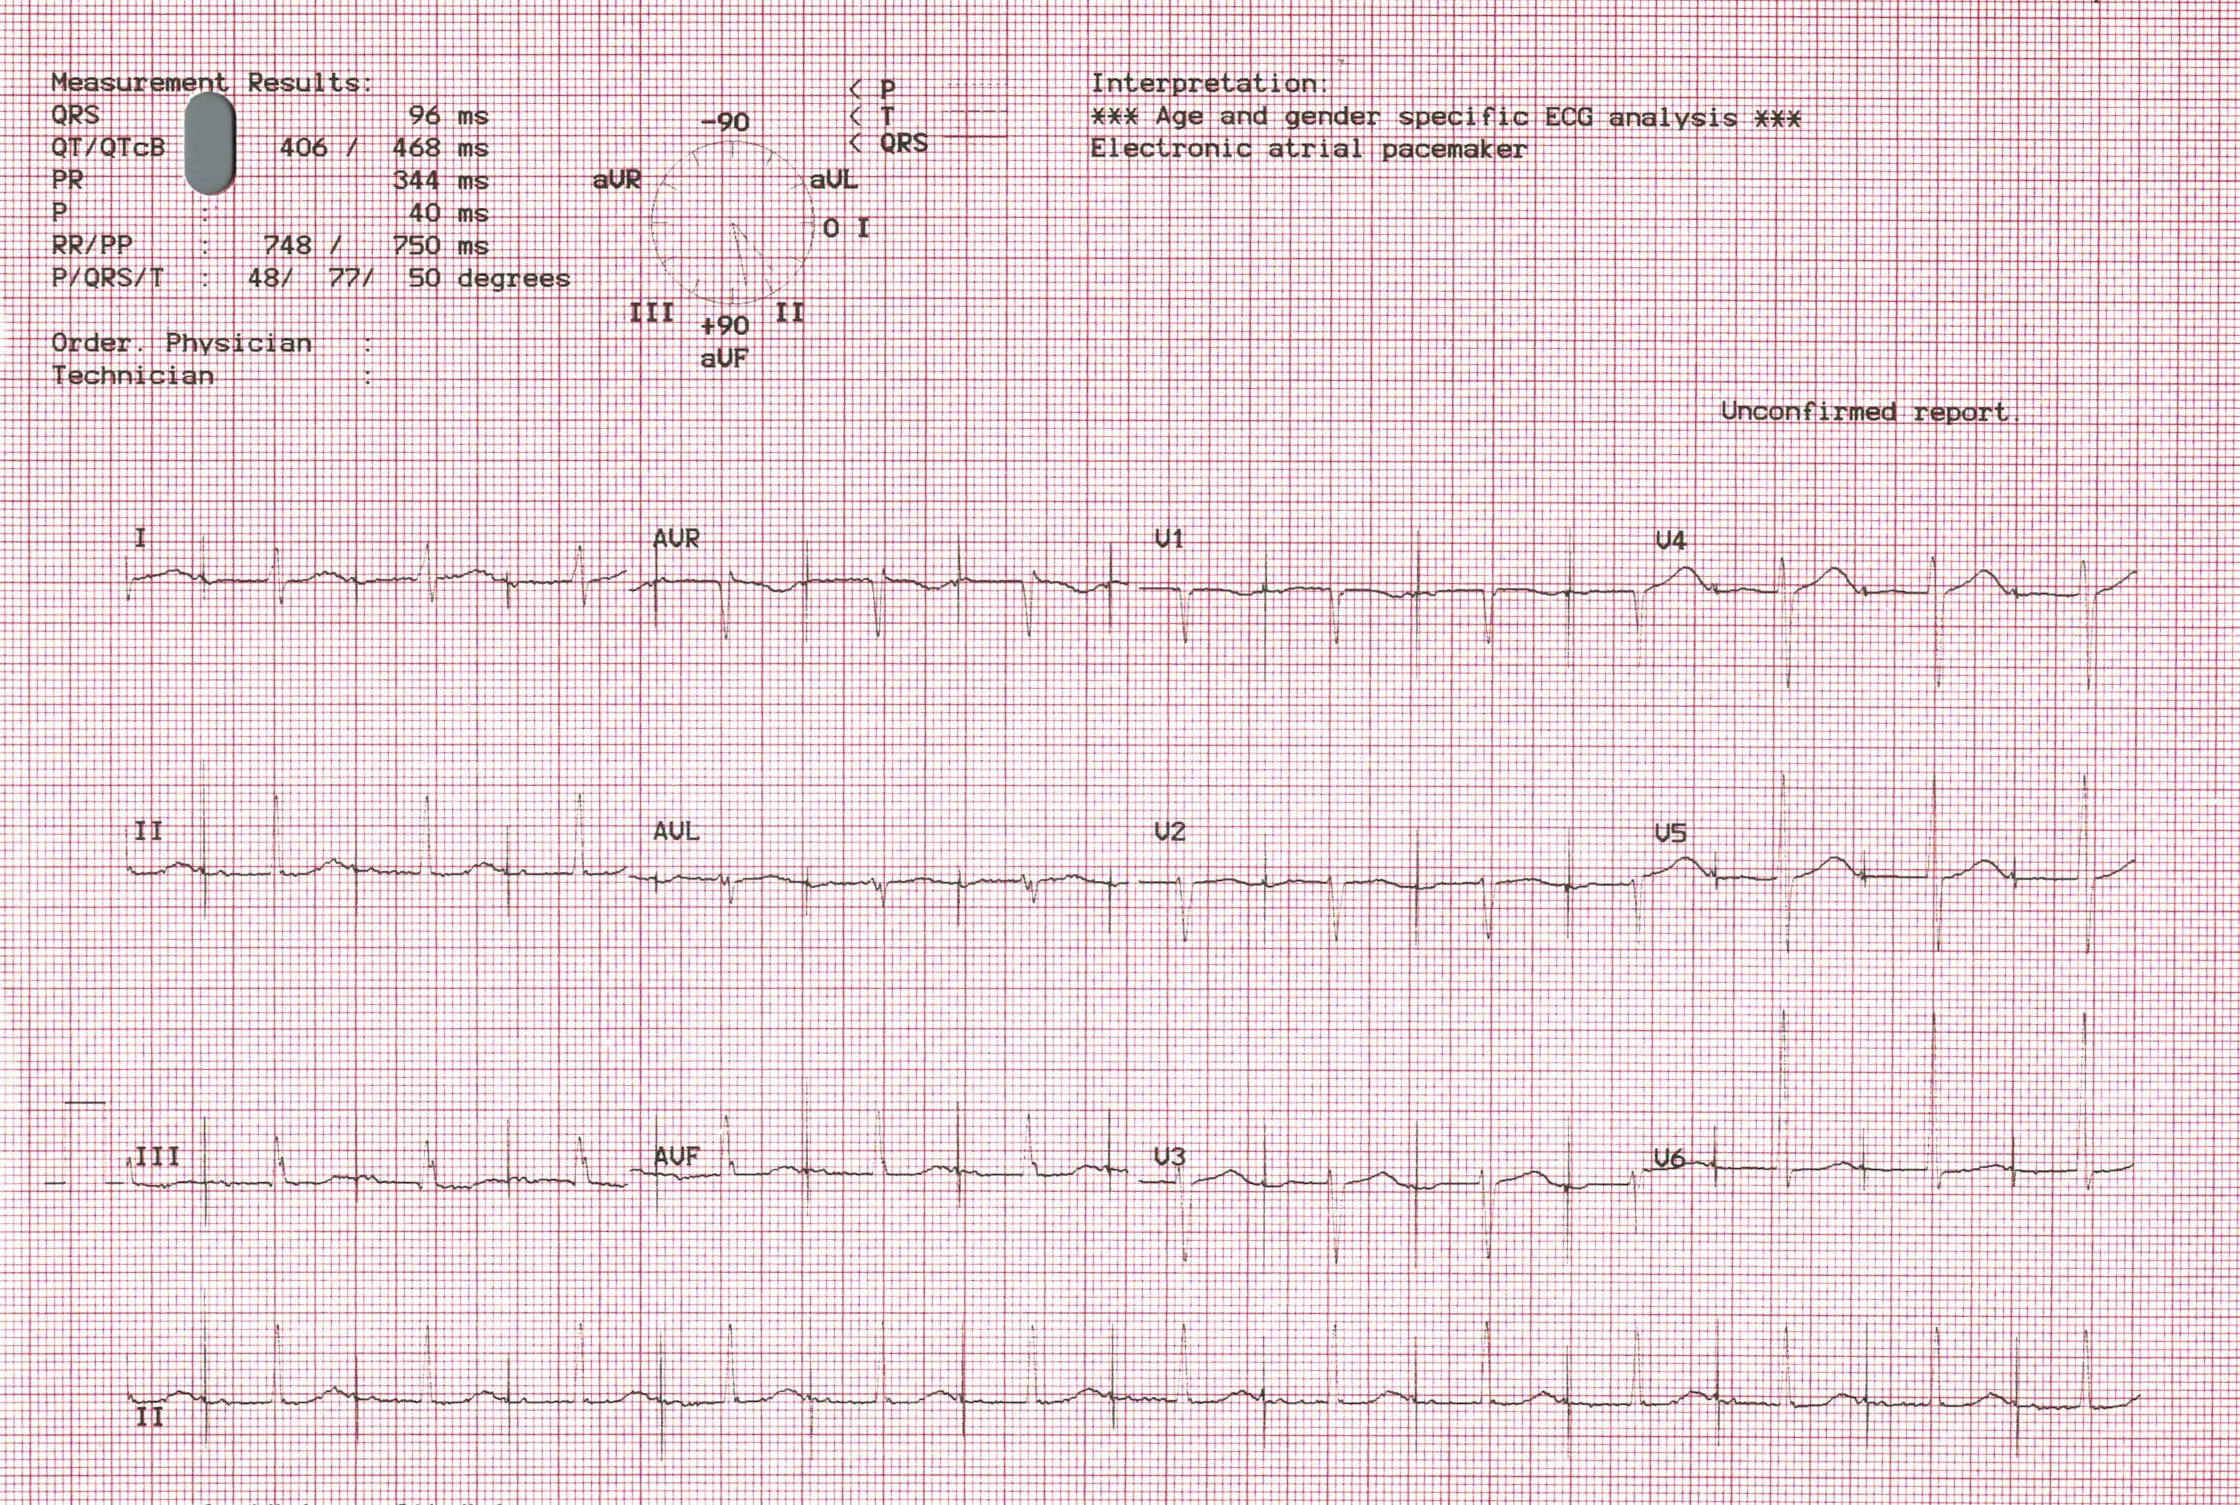
Hybrid Therapy
Atrial Resynchronization after AF ablation x4
6/23 – Dronedarone intolerance; on no AADs, no AF or HFpEFrecurrence
2023-25 – On metoprolol
4/ 2025- Remains in atrial paced rhythm free of HF

